Slide 1
Sauna WiFi Automation
Randy Pfeifer
Caution! The enclosed information involves wiring and potential re-wiring of electrical equipment which operates at dangerous voltages and currents.
Providing this information is not a suggestion that you the reader are capable of applying it in your individual product or that you have the skills necessary to do so.
Do not attempt to make any of the documented changes to your equipment or implement any of the enclosed designs if you are not fully qualified to do so. Loss of warranty status or risk of injury may be experienced.
If you have any questions whatsoever about the attached material, you wish to consult with or hire an electrical expert to ensure your safety.
While everything in the attached material has been implemented by the author, no warranty of accuracy is expressed or implied.

Slide 2
Notes
This design utilizes a WiFi Smart switch to activate/idle a sauna heater system.
The sauna heater is internally controlled via a contactor. The contactor must be controllable with a 120V AC signal.
Some contactors may be wired / operating with 240V AC
Some of those contactors may be rated for use with 120V AC
If the heater has a contactor which will operate at 120V AC, this approach will work.
A separate sauna controller has a timer, thermostat and possibly switches for internal lights for the sauna room
With this approach, the timer is defeated in some fashion. The output of the thermostat controls the contactor in series with the WiFi Smart switch to turn the heater on and off as the temperature sensor dictates.
Details of timer bypass and switches for lighting are beyond the scope of this analysis and likely unique to any given heater/controller manufacture / model.
Additional information is shown to allow visual display of Sauna status but is optional and unrelated to the use of a WiFi Smart switch to remotely control the sauna heater

Slide 3
Schematic diagram (Insertion of WiFi Smart switch in Contactor path)
Heat sensor (in sauna)
“Alexa, turn on the Sauna”
L1
WiFi Smart
switch
Turn-ON – (T)
Thermostat
120 VAC
Many details of heater removed for clarity (e.g., grounding, over temp limit switch, heating element configuration, etc.)
N
Sauna Controller
(in changing room)
Optional
Sauna
Status
Signaling
Call for Heat (C)
240 VAC
Contactor
Heating
Elements
L2
For simplification of drawing, ground connections not shown
Voltage of all lines are 120V AC relative to Neutral (N)
L1-to-L2 Voltage is 240V AC
Heater

Slide 4
Sauna Status Signaling (Optional) State Diagram
Lights
!T
T*C
RED
!T
RED
T*C
Off
Yellow
T = Turn ON,
!T =Turn OFF (not ON)
C = Call for Heat/ Cycle
!C = Not calling for heat
T*C = T AND C
!T
Yellow
Warming
Up
!T
!C
Green
Green
Ready!
States reflect color of light lit while in a given state
T

Slide 5
State Simulation
”Alexa, turn off the Sauna”
WiFi Switch ON
“Alexa, turn on the Sauna”
Sauna reaches target temp
(Thermostat shuts off heater)
120VAC
T
0VAC
C
State
Red Yellow Green
Red
Once Sauna is up to target temp, Green light stays on even as thermostat cycles on/off
until sauna is shut off by WiFi switch or manually.

Slide 6
Components for Sauna Signaling
Components for WiFi Control
https://www.amazon.com/gp/product/B07HGW8N7R/ref=ppx_yo_dt_b_search_asin_title?ie=UTF8&th=1
quantity | Part number | Description | Price | As of
4 EACH | 46.52.8.120.0040 | FINDER MIN. INDUSTRIAL RELAY DPDT 8A 120V AC | $6.94 each | 9/17/21
4 EACH | 97.02 | FINDER DIN -RAIL/PANEL MOUNT SCREW TERMINAL (BOX | $4.13 each | 9/17/21
Available from many sources
External lights – 120V AC compatible Red, Yellow, Green – or any colors of your choice)
An example: https://www.amazon.com/gp/product/B07FXCGDDX/ref=ppx_yo_dt_b_search_asin_title?ie=UTF8&psc=1

Slide 7
Relay implementation of Sauna Signaling State machine
4 Relays
T – activated when signal T arrives - SPDT
C – activated when signal C arrives - DPDT
C-Save – Saves the prior state of relay C - DPST
G-Save – Saves the prior state of relay G - DPDT
SPDT
N
T
C
CS
GS
DPDT
SPDT = Single Pole Double Throw
DPDT= Double Pole Double Throw
DPST = Double Pole Single Throw
N
DPST
All relays purchased are DPDT. A subset of connections are used for SPDT and DPST cases.
N

Slide 8
Relay Implementation
T
T
Lights are 120 VAC lights
L1
N
Gsave₂
C₂
Gsave₁
Csave₂
N
C
GSave
C
C₁
N
Csave
N
Subscripts (e.g., Gsave₂) refer to which pole in the relay is used
Csave₁
N

Slide 9
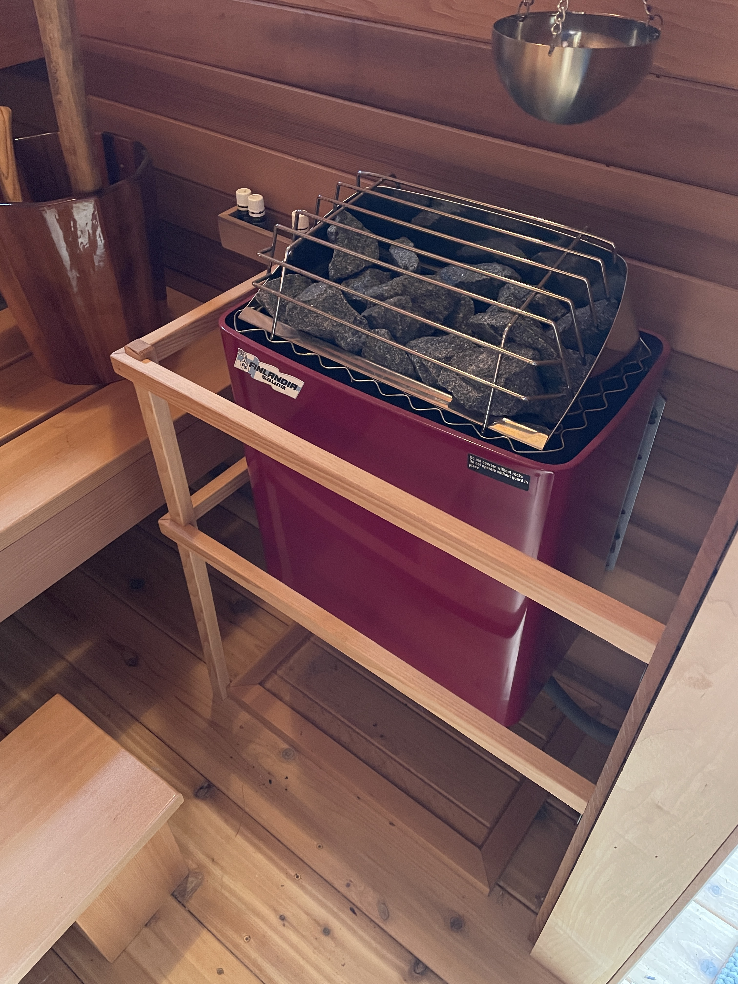
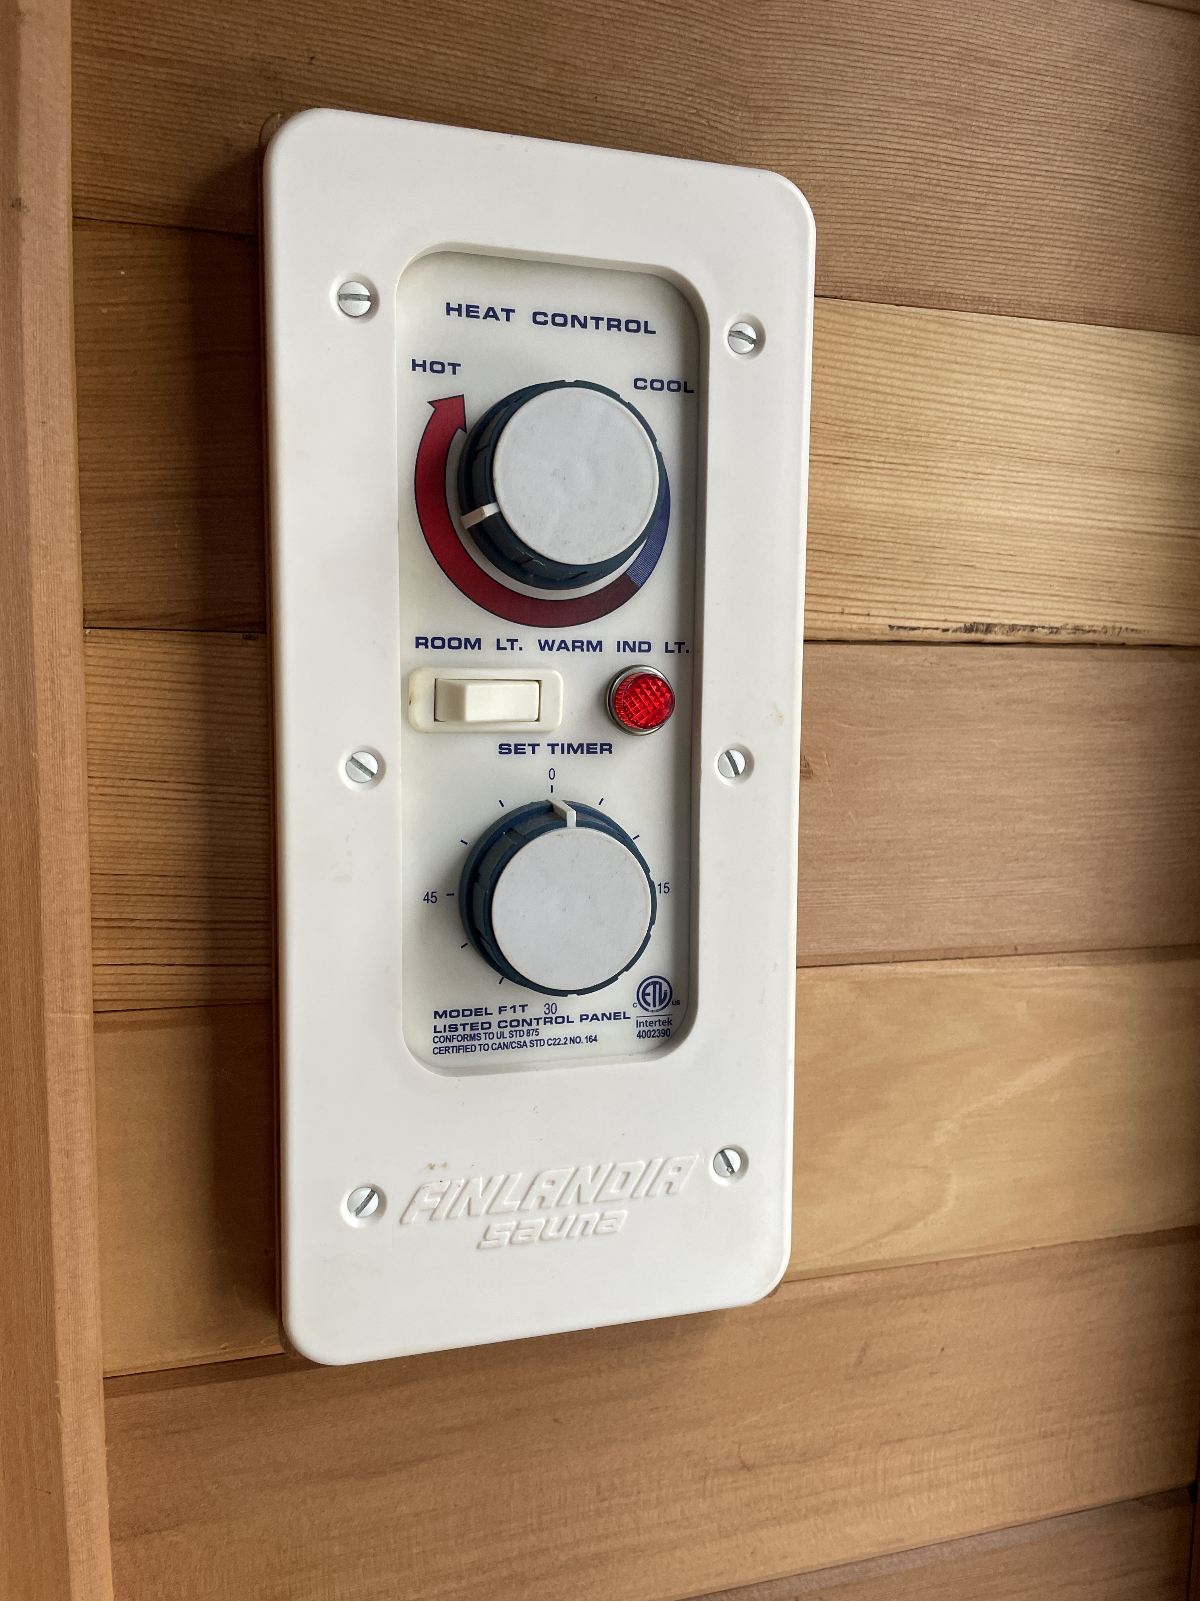
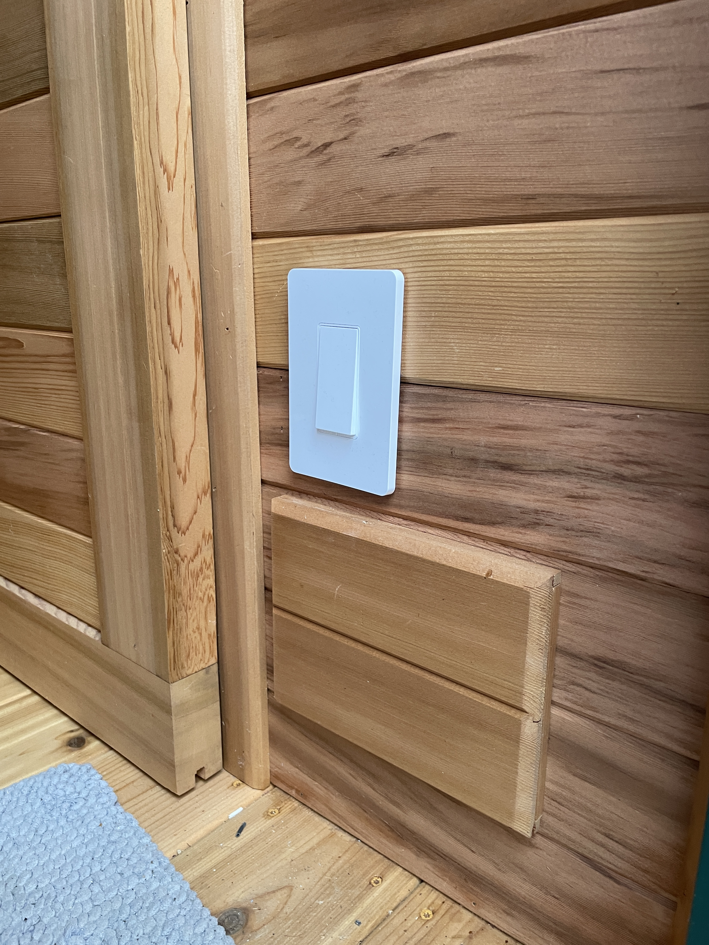
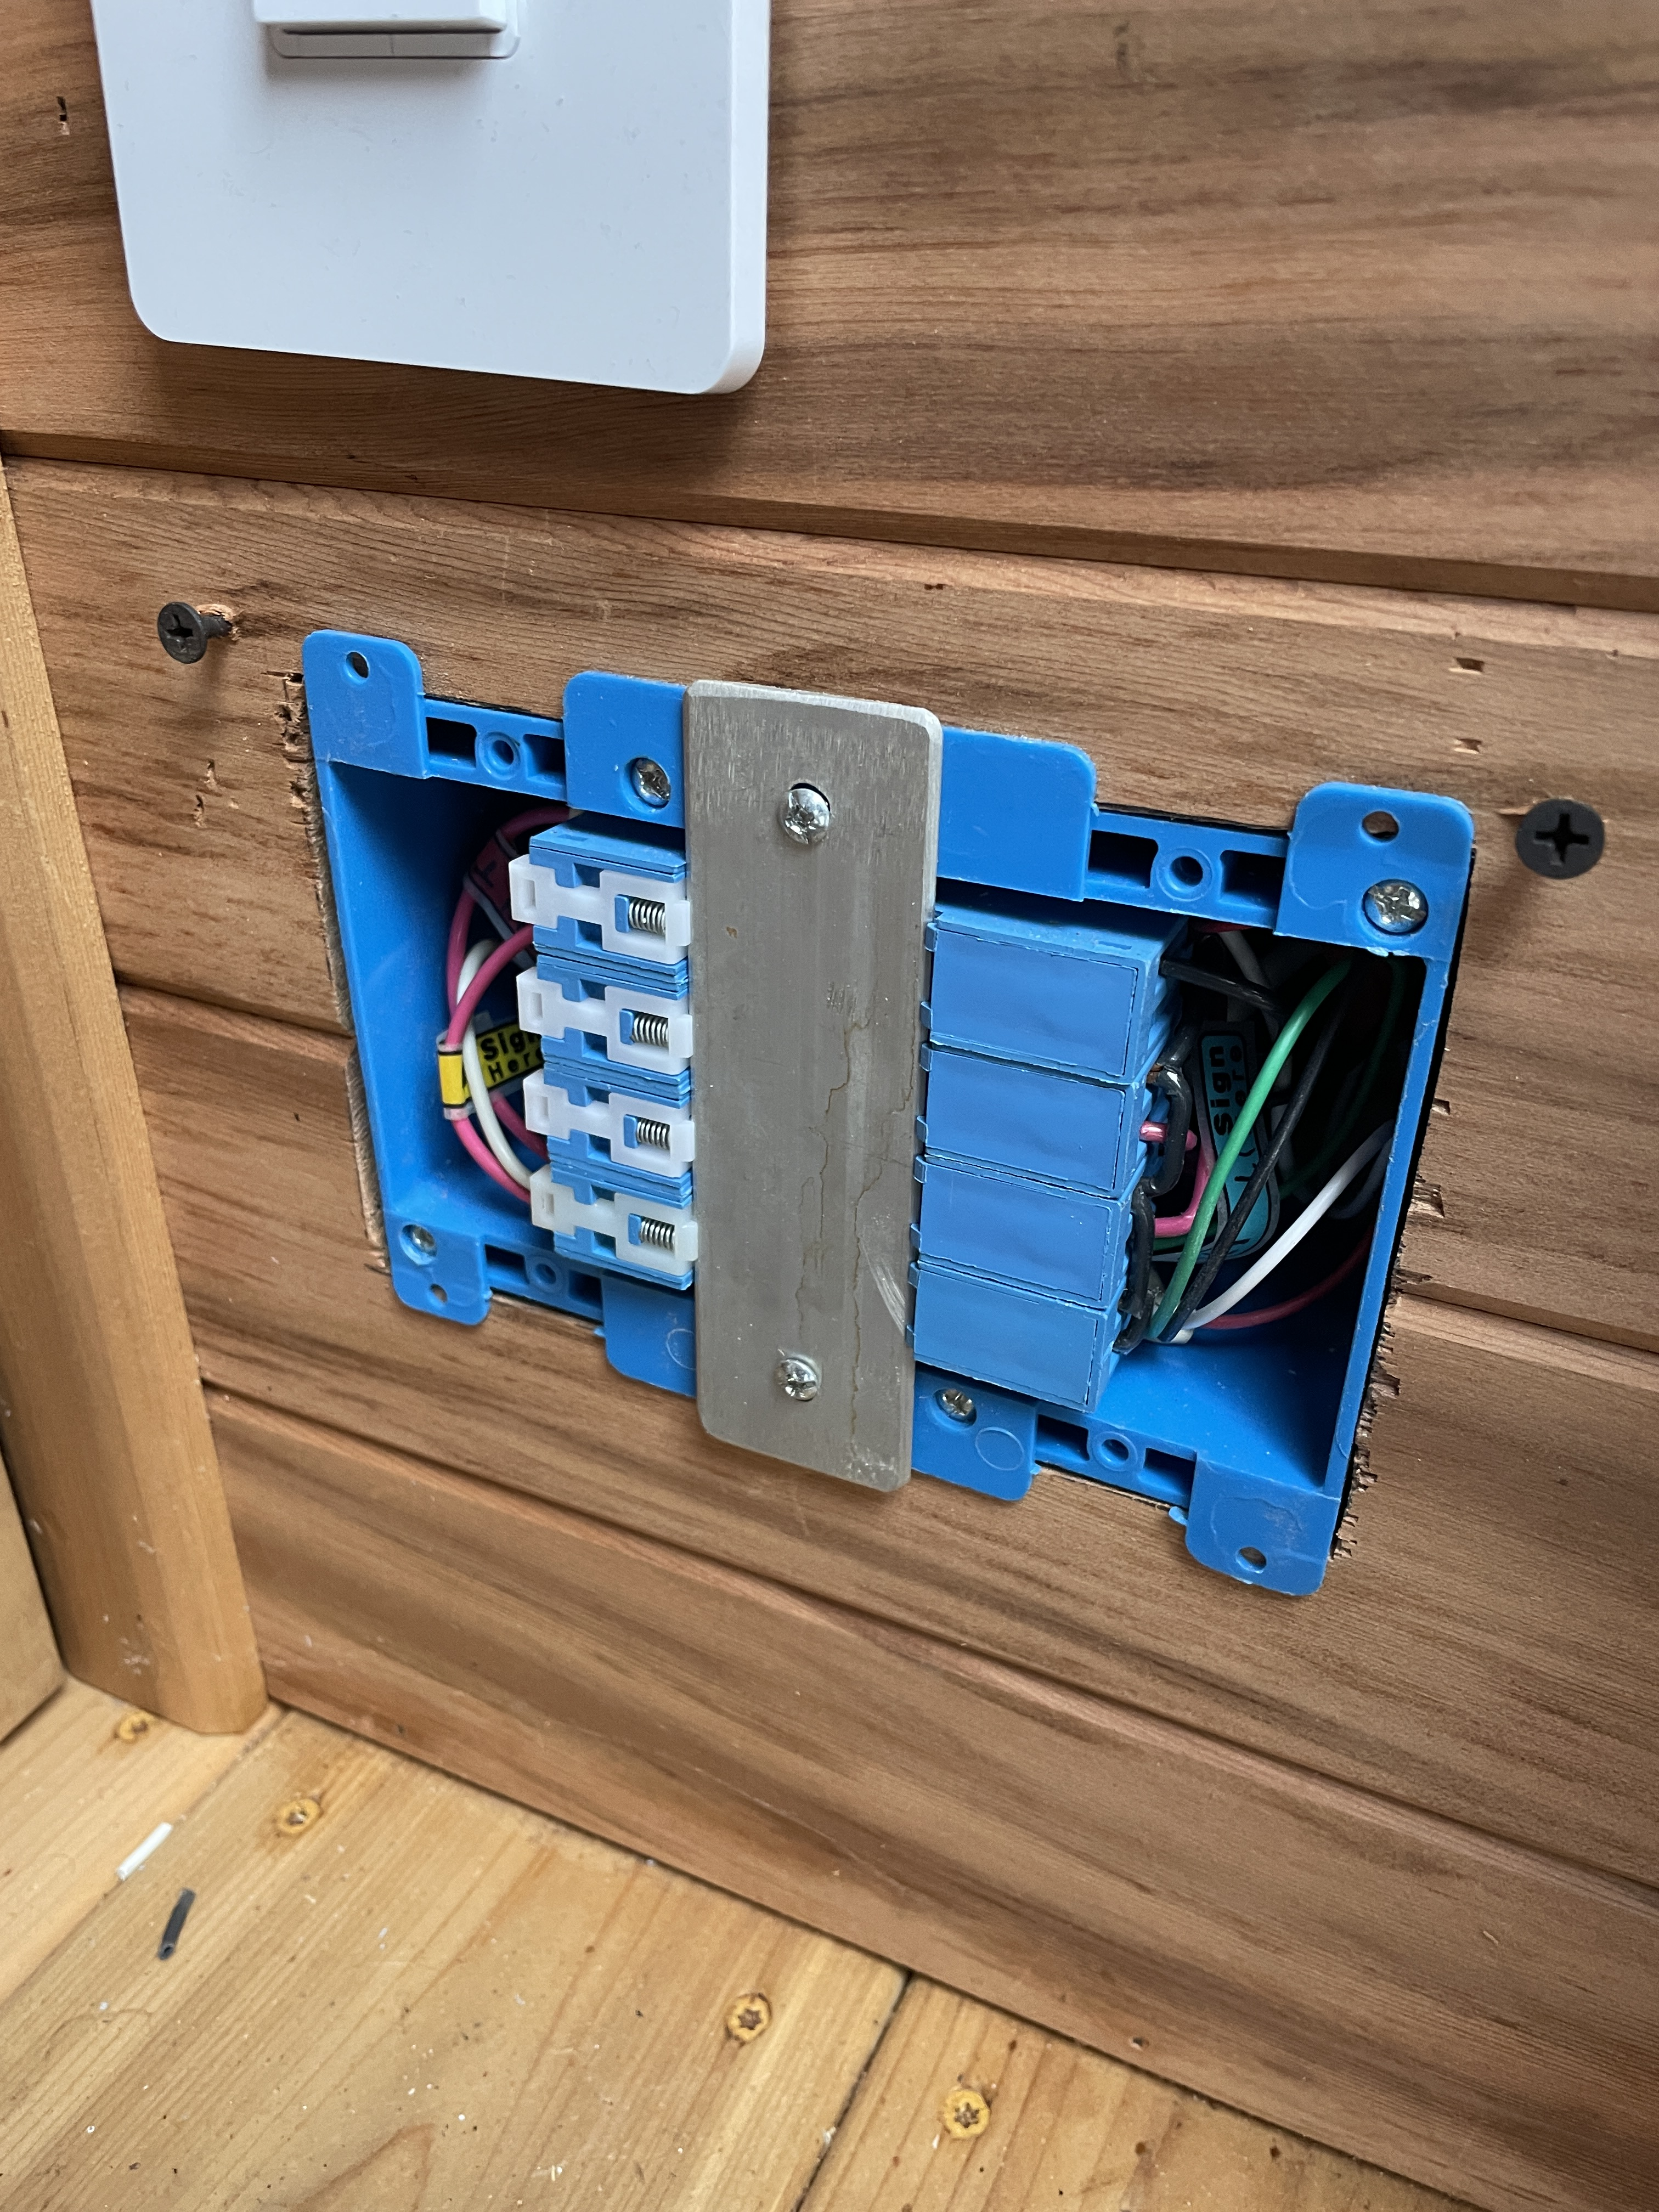
Pictures of implementation
Original Controller
F-1T Finlandia
Finlandia 6KW heater
Relays wired in wall and wired to WiFi switch (T) and heater thermostat (C).
Drives 120VAC to selected light outside.
WiFi Switch and panel
covering relays.
Low on wall between changing room and hot room – never hot there.
Controlled by Alexa or manually operating switch.

